Slide 1

Engineering Notebook
The Bionic Tigers - FTC 10464

Slide 2
What is an engineering notebook?
The engineering notebook is a documentation of the team’s robot design and records the time spent doing research, outreach, team meetings, and plans for growth

Slide 3
What is an engineering notebook?
The engineering notebook is a documentation of the team’s robot design and records the time spent doing research, outreach, team meetings, and plans for growth

Slide 4
Why do we need an engineering notebook?

Slide 5
Reasons
Throughout the process of designing and building a robot, teams will come across obstacles, lessons learned, and the need to draw ideas out on paper
One of the goals of FIRST and FIRST Tech Challenge is to recognize the engineering design process and the journey that a team makes.
Judges review a team’s engineering notebook to better understand the journey, design, and team as a whole.
Notebooks track a team from the beginning of the season and throughout the competition season

Slide 6
Engineering notebook requirements

Slide 7
Requirements
Teams may only have one notebook at a competition
Team number and team name must appear on the outside cover
Must have a summary page in the front of the engineering notebook
The engineering notebook must be divided into multiple sections:
Engineering section (that includes design process)
Team section (that includes information about the team and outreach activities)
Business/strategic plan (not required, but needed for specific awards)

Slide 8
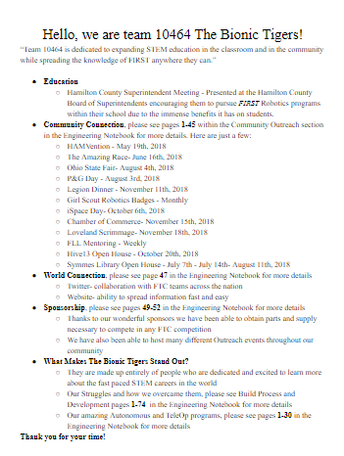
Summary Page
One page
Include team number
Include a concise narrative about the team
Bulleted highlights of the team’s season
List of pages in the engineering notebook the team would most like the judges to consider

Slide 9
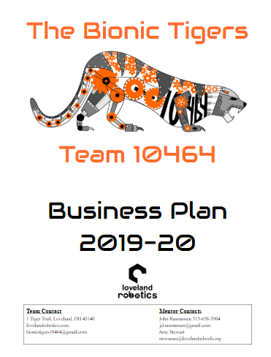
Business/Strategic Plan
Unique for every team
May touch on the following needs:
Direction the team wants to take
Outlining team goals
Type of outreach team wants to focus on
Creating a team budget
Fundraising needs
Seeking out sponsors
Explains steps to be taken by team to reach goals

Slide 10
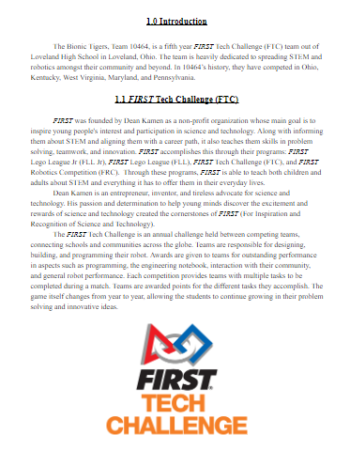
Business/Strategic Plan
Use as a guide for team
Layout team goals--short or long term
Fundraising
Outreach
Competition
Include a plan for team sustainability
Plan explains how the team plans to grow and stay competitive when students graduate from the program.
May include plans to recruit sponsors, new mentors, or team members.

Slide 11
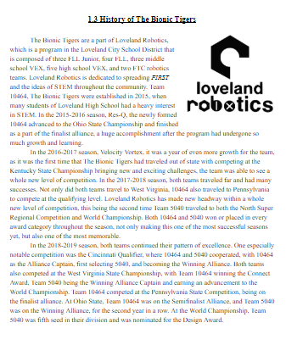
Business/Strategic Plan
Things to do include:
Overview of FTC and the game
Team history
Outreach
Team involvement in community
Sponsorship details
Budget
Team goals
Sustainability

Slide 12
What to include in your team’s engineering notebook

Slide 13
Include
Sections and subsections
Team
Business/strategic plan
Outreach
Engineering (design process)
Programming
Meeting entries
Table of contents
Makes it easier for judges to find documentation

Slide 14
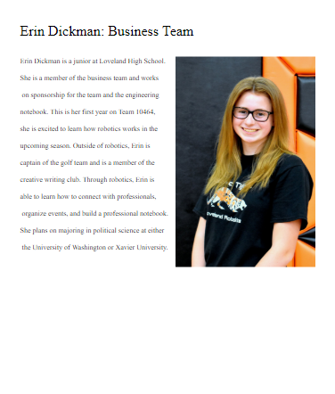
Team Section
Team member bios
School year
Interests
Activities outside of robotics
Team role
Future plans
What got them interested
Mentor bios
Career
Team involvement
Personal history
Information about team
Hometown
Age
School

Slide 15
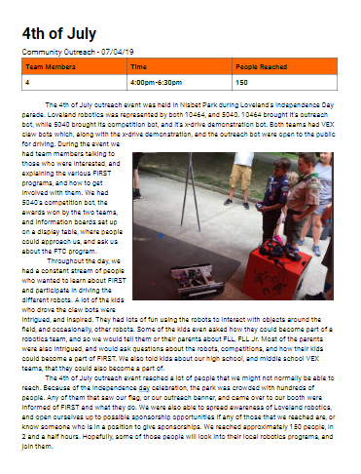
Outreach Section
Entry for each event/experience
Photos of the event
Explain the significance and impact
Give many details
Include takeaways

Slide 16
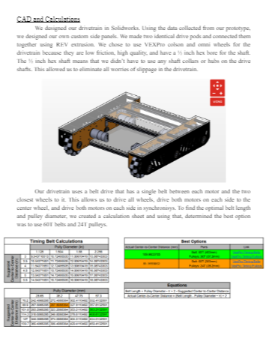
Engineering (Design) Section
Very important and large section
Include every thought about the robot from the game reveal to the last competition
Include many visuals from napkin sketches to photos to CAD drawings, math equations, and etc
Journey to your current robot design
Each part of robot has own part of section--its iterations

Slide 17
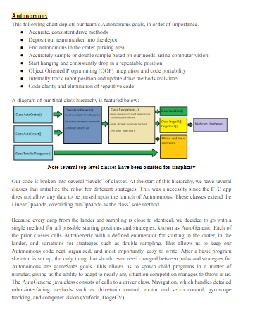
Programming Section
Overview of programming process
Reasons for a specific process
Implications of a sensor
Flowcharts and diagrams
Controller setup
Configuration of motors and servos
DO NOT PRINT OUT ALL OF YOUR CODE!
Only parts that you want to explain or showcase

Slide 18
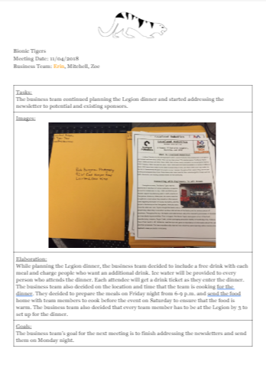
Meeting Entries Section
Details about meeting
Date
Time
Location
Intentions
What was completed that meeting
What is ongoing

Slide 19
How to organize your engineering notebook

Slide 20
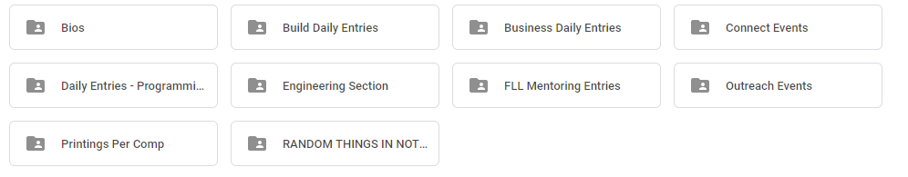
Organization
Google Drive folder for whole team
Have a folder for each section and subsection
Develop a template for each style of entry
Print your notebook well ahead of time

Slide 21
Keep in mind
The notebook is live document
Main objective is to showcase your journey
Visuals, visuals, and visuals
Keep it consistent
Section summaries
Every page needs to be signed and dated by team members

Slide 22
Super helpful materials to check out:
FTC Team Management Documents
FTC Engineering Notebook Guide

Slide 23

Credits
This lesson was written by The Bionic Tigers 10464 for FTCTutorials.com
You can contact the author at:
Website:
http://lovelandrobotics.com/team10464
Twitter:
@BionicTigersFTC
Email:
BionicTigers10464@gmail.com
More lessons for FIRST Tech Challenge are available at www.FTCtutorials.com
This work is licensed under a
Creative Commons Attribution-NonCommercial-ShareAlike 4.0 International License.

